Slide 1
Introduction to Artificial Intelligence
Unit I

Slide 2
What is AI
AI is the study of agents that receive perceptions from the environment and perform actions.

Slide 3
Artificial Intelligent
Artificial Intelligence is the study of how to make computers do things at the moment, and do better [1].
AI important elements:
Systems that think like humans
Systems that act like humans
Systems that think rationally
Systems that act rationally

Slide 4
Artificial Intelligence is composed of two words Artificial and Intelligence, where Artificial defines "man-made," and intelligence defines "thinking power", hence AI means "a man-made thinking power."

Slide 5
Brief history of AI
Year | Milestone
1950 | Alan Turing — “Can machines think?”
1956 | Term Artificial Intelligence coined
1970s–90s | Expert systems, rule-based AI
2010+ | Data + ML + Deep Learning boom

Slide 6
Applications of AI
Optical character recognition
Handwriting recognition
Speech recognition
Face recognition
Gaming
Artificial creativity
Computer vision, Virtual reality, and Image processing
Photo and Video manipulation
Diagnosis (artificial intelligence)

Slide 7
Advantages of AI
High Accuracy with less errors: AI machines or systems are prone to less errors and high accuracy as it takes decisions as per pre-experience or information.
High-Speed: AI systems can be of very high-speed and fast-decision making, because of that AI systems can beat a chess champion in the Chess game.
High reliability: AI machines are highly reliable and can perform the same action multiple times with high accuracy.
Useful for risky areas: AI machines can be helpful in situations such as defusing a bomb, exploring the ocean floor, where to employ a human can be risky.

Slide 8
Digital Assistant: AI can be very useful to provide digital assistant to the users such as AI technology is currently used by various Ecommerce websites to show the products as per customer requirement.
Useful as a public utility: AI can be very useful for public utilities such as a self-driving car which can make our journey safer and hassle-free, facial recognition for security purpose, Natural language processing to communicate with the human in human-language, etc.

Slide 9
Disadvantages of AI
High Cost: The hardware and software requirement of AI is very costly as it requires lots of maintenance to meet current world requirements.
Can't think out of the box: Even we are making smarter machines with AI, but still they cannot work out of the box, as the robot will only do that work for which they are trained, or programmed.

Slide 10
Increase dependency on machines: With the increment of technology, people are getting more dependent on devices and hence they are losing their mental capabilities.

Slide 11
Foundations of AI and sub areas of AI:
AI into five distinct research areas
Machine Learning
Expert Systems
Computer Vision
Natural Language Processing Robotics

Slide 12
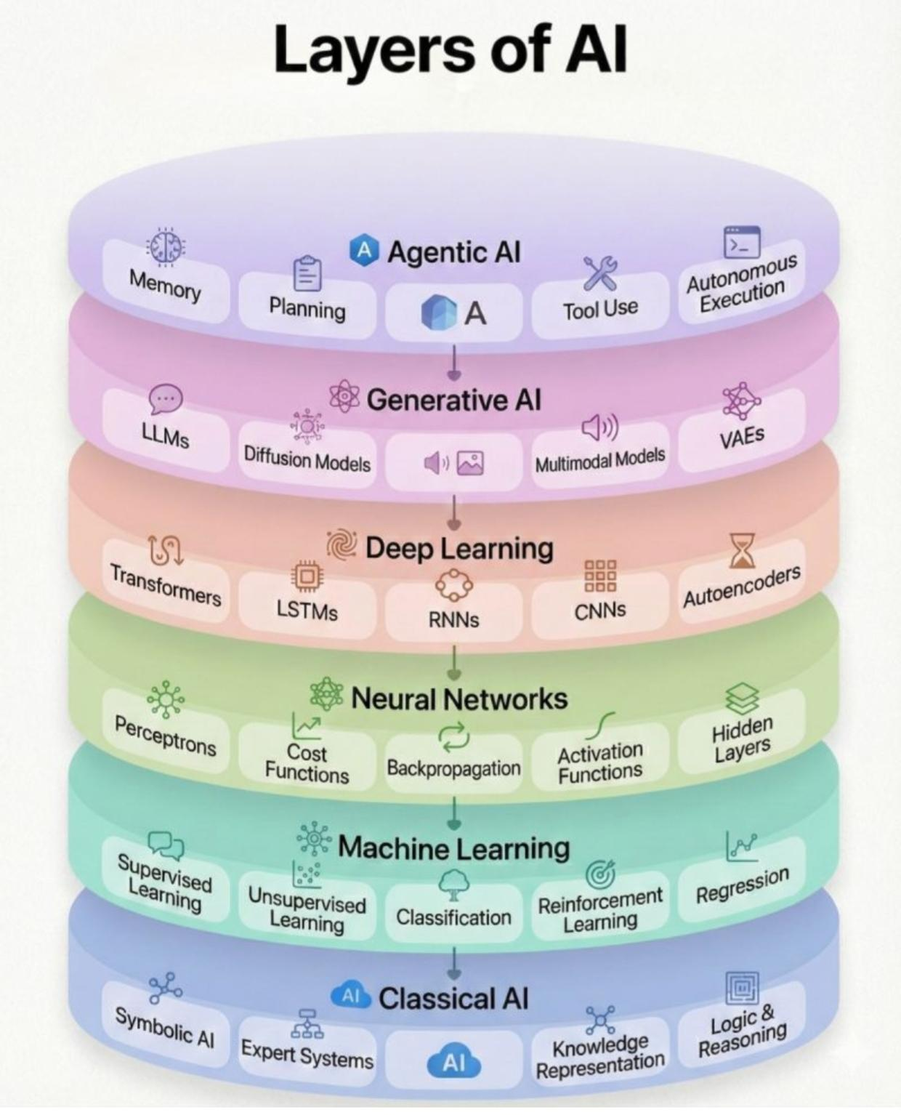

Slide 13
Intelligent Agent
An agent is anything that can be viewed as perceiving its environment through sensors and acting upon that environment through actuators shown in Figure[1]
Sensor input
Environment
percepts
Agent
action
Figure: Agent interaction with environment

Slide 14
Types of Intelligent Agents
Simple reflex, Model-based, Goal-based, Utility-based, Learning
Examples:
Thermostat (Simple)
Robot vacuum (Model-based)
GPS Navigation (Goal-based)
Recommender (Utility-based)
Spam filter (Learning)

Slide 15
Agent Function and Agent Program
Agent action is decided upon any input perceived by any agent.
Agent program is the action taken against that percept sequence

Slide 16
Good behaviour
Rationality: Agent selects action which maximizes the performance
Learn: Agent should learn from perceive sequences
Omniscient: Agent should know the outcome of its actions
Autonomous: Agent should compensate for half/inaccurate knowledge

Slide 17
Nature of environments
Specifying the task environment
task environment specification includes the performance measure, the external environment, the actuators, and the sensors

Slide 18
Nature of environments
Task performance can be measured by following parameters
PEAS (Performance, Environment, Actuators, Sensors) description

Slide 19
Example: Taxi Driver
Taxi Driver = Agent Type
Safe, fast, legal, comfortable trip, maximize profits =Performance Measure
Roads and other traffic, pedestrians, customers=Environment
Steering, accelerator, brake, signal horn, display=Actuators
Cameras, sonar, speedometer, GPS, odometer, accelerometer, engine sensors, keyboard =Sensors

Slide 20
Problem Solving in AI
AI solves problems by search.
Start state → Operators → Goal state
Examples: Shortest path in Google Maps Maze solving

Slide 21
Steps in Problem Solving in AI
AI problem solving follows a structured, logical process similar to human thinking, its steps include:
Problem Definition: First, the problem needs to be clearly defined. This includes understanding the inputs, constraints and what the solution should look like.
Problem Analysis: Once the problem is defined, it’s analyzed in more detail. This helps in understanding its limitations and possible solutions.

Slide 22
3. Knowledge Representation: All the important information is organized so the AI can understand and work with it. This could include creating graphs or using databases.
4. Problem Solving: AI uses appropriate methods to solve the problem. This often means comparing different strategies to find the most efficient one.
5. Testing and Evaluation: Finally, after the solution is implemented, testing and evaluation ensure the solution meets all requirements and performs as expected.

Slide 23
Types of Problems in AI
Ignorable Problem
Recoverable problem
Irrecoverable problem

Slide 24
Key Components of Problem Formulation in AI
Initial State: This is the starting point of the problem where the AI begins its process. It sets the context and helps identify how the agent will approach the challenge.
Action: At this stage, AI identifies all the possible actions it can take from the initial state. Each action has an impact on how the system moves closer to solving the problem.

Slide 25
Transition: This refers to how the system changes from one state to another after an action is taken. Transition modeling helps show how the agent’s actions influence the next steps.
Goal State: Once an action is taken, AI checks if it has reached its goal. If the goal is achieved, the problem-solving process stops and the solution is considered complete.
Cost Function: This step assigns a numerical value to the cost of achieving the goal. The cost can include resources like time, energy or money and helps decide the most efficient way to reach the goal.

Slide 26
Initial state, actions, and transition model together define the state-space of the problem implicitly. State-space of a problem is a set of all states which can be reached from the initial state followed by any sequence of actions.
The state-space forms a directed map or graph where nodes are the states, links between the nodes are actions, and the path is a sequence of states connected by the sequence of actions.

Slide 27
Search: It identifies all the best possible sequence of actions to reach the goal state from the current state. It takes a problem as an input and returns solution as its output.
Solution: It finds the best algorithm out of various algorithms, which may be proven as the best optimal solution

Slide 28
Example Problem: 8 word Puzzle
Here, we have a 3×3 matrix with movable tiles numbered from 1 to 8 with a blank space. The tile adjacent to the blank space can slide into that space.
The objective is to reach a specified goal state similar to the goal state, as shown in the below figure

Slide 29
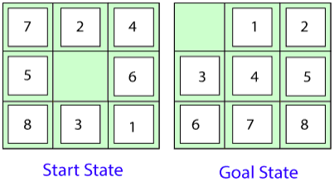
In the figure, our task is to convert the current state into goal state by sliding digits into the blank space.

Slide 30
In the above figure, our task is to convert the current(Start) state into goal state by sliding digits into the blank space.
The problem formulation is as follows:
States: It describes the location of each numbered tiles and the blank tile.
Initial State: We can start from any state as the initial state.
Actions: Here, actions of the blank space is defined, i.e., either left, right, up or down
Transition Model: It returns the resulting state as per the given state and actions.

Slide 31
Goal test: It identifies whether we have reached the correct goal-state.
Path cost: The path cost is the number of steps in the path where the cost of each step is 1.
Note: The 8-puzzle problem is a type of sliding-block problem which is used for testing new search algorithms in artificial intelligence.

Slide 32
Measuring problem-solving performance
Before discussing different search strategies, the performance measure of an algorithm should be measured.
Consequently, There are four ways to measure the performance of an algorithm:
Completeness: It measures if the algorithm guarantees to find a solution (if any solution exist).
Optimality: It measures if the strategy searches for an optimal solution.

Slide 33
Time Complexity: The time taken by the algorithm to find a solution.
Space Complexity: Amount of memory required to perform a search. The complexity of an algorithm depends on branching factor or maximum number of successors, depth of the shallowest goal node (i.e., number of steps from root to the path) and the maximum length of any path in a state space.

Slide 34
Techniques for Problem Solving in AI
1. Search Algorithms
2. Constraint Satisfaction Problems (CSP)
3. Optimization Techniques

Slide 35
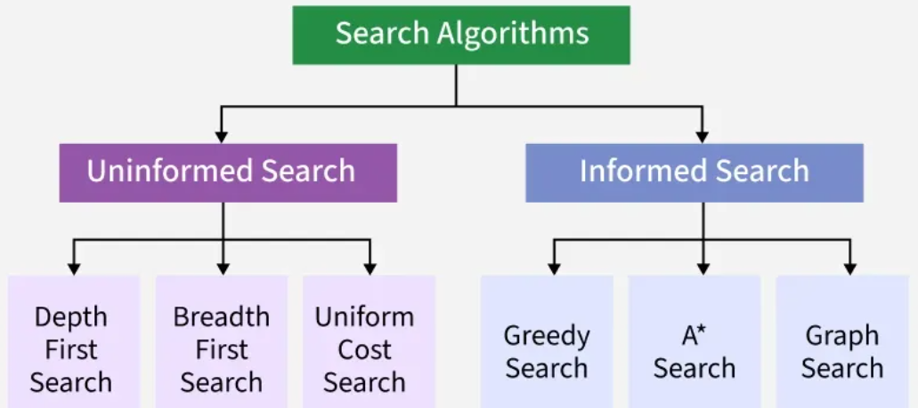
1. Search Algorithms

Slide 36
Uninformed Search
Uninformed search, also called blind search, is an algorithm that explores a problem space without prior knowledge, focusing solely on the initial state and possible actions.

Slide 37
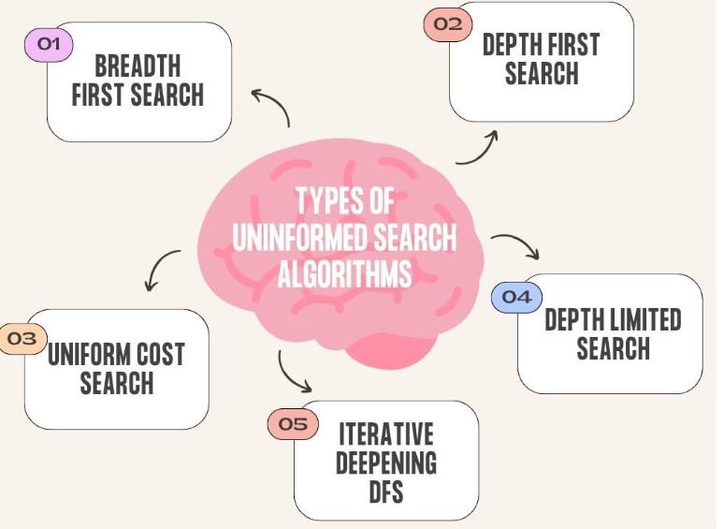

Slide 38
Breadth First Search
Breadth First Search ( BFS ) is used to explore all the neighbouring states or nodes of the initial node, thus guaranteeing the shortest path between nodes in a tree-like data structure.
It is used to reach the goal state using the shortest path between the initial and goal state.

Slide 39
The Queue data structure is used in BFS. The initial node is first pushed into the Queue, and then after visiting the front node, all the neighboring nodes are pushed into the Queue.
Thus, it ensures that the goal state is reached using the shortest path by exploring all the neighbors at once.
Solve the examples for the same

Slide 40
Depth First Search
Depth First Search ( DFS ) is used to find the solutions by exploring all the nodes till the end of a branch is reached and then backtracking and exploring other branches in the same way.
It is a recursive algorithm. DFS searches along each branch by going into the deep.

Slide 41
The Stack data structure is used in DFS in a similar way queue was used in BFS. First, the initial state is pushed into the stack, and then the top element is popped out, and its neighbors are pushed into the stack.
In this way, it makes sure to traverse along each branch separately.

Slide 42
Informed Search
It uses domain knowledge in the form of heuristics to make smarter decisions during the search process.
These heuristics estimate how close a state is to the goal guiding the search more efficiently.
This search maintains some sort of internal states via heuristic functions (which provides hints), so it is also called heuristic search.

Slide 43
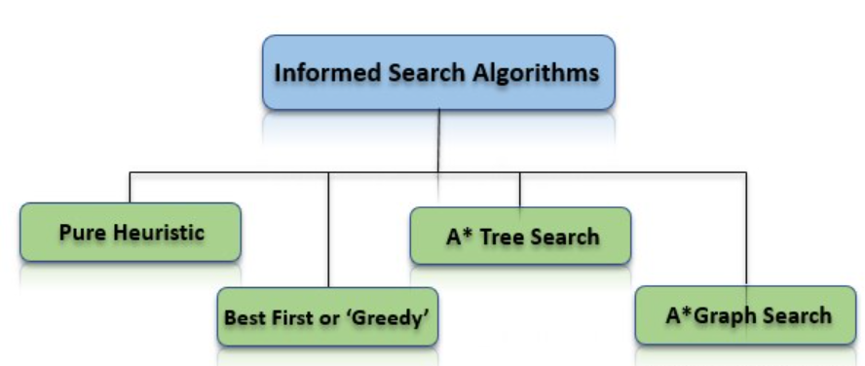

Slide 44
What is the role of knowledge
Though one could have unlimited computing power, the size of the knowledge base available for solving the problem does matter in arriving at a good solution.
Take for example the game of playing chess, just the rules for determining legal moves and some simple control mechanism is sufficient to arrive at a solution.

Slide 45
But additional knowledge about good strategy and tactics could help to constrain the search and speed up the execution of the program. The solution would then be realistic.

Slide 46
Heuristics Search
A Heuristic is a technique to solve a problem faster than classic methods, or to find an approximate solution when classic methods cannot.
This is a kind of a shortcut as we often trade one of optimality, completeness, accuracy, or precision for speed.

Slide 47
A Heuristic (or a heuristic function) takes a look at search algorithms.
At each branching step, it evaluates the available information and makes a decision on which branch to follow.
It does so by ranking alternatives. The Heuristic is any device that is often effective but will not guarantee work in every case.

Slide 48
So why do we need heuristics? One reason is to produce, in a reasonable amount of time, a solution that is good enough for the problem in question.
It doesn’t have to be the best an approximate solution will do since this is fast enough. Most problems are exponential.
Heuristic Search let us reduce this to a rather polynomial number.
We use this in AI because we can put it to use in situations where we can’t find known algorithm.

Slide 49
Best first Search (Greedy search)
Greedy search is a heuristic based algorithm that selects the path which appears to lead most directly toward the goal.
It makes decisions based solely on the estimated cost from the current node to the goal (h(n)) ignoring the cost already taken to reach the current node (g(n)).
This approach makes greedy search fast and memory efficient as it focuses only on immediate gains.

Slide 50
A* Tree
The A* Search Algorithm is an optimal and efficient method for solving pathfinding problems. When seeking the shortest path between a starting point and a goal, A* is often the best choice due to its versatility and robustness.
Widely used in robotics, video games, and navigation systems, A* is one of the most important algorithms in graph traversal.
Pathfinding involves finding a viable route between two points in a given space while adhering to a set of rules.

Slide 51
The A* algorithm is known for identifying the most efficient path from one point to another. It combines the strengths of two powerful algorithms: Dijkstra’s algorithm and Greedy Breadth-First Search.
In a*, the space is represented as a graph, where nodes represent positions or states and edges represent transitions between states. Edges are associated with costs or a given set of rules. The algorithm moves from the first node to the goal in consideration of the least-cost path.
A* Search Algorithm formula calculates the cost of reaching a particular node.

Slide 52
The total cost of traversal is calculated as:
f(n)=g(n)+h(n)
Where:
f(n) is the estimated total cost from the start node to the end goal via node n.
g(n) is the actual cost from the start node to node n.
h(n) is the heuristic cost (estimated cost) from node n to end node.
This heuristic cost or the guess of the remaining cost to the end goal is this algorithm's additional function, making it optimal amongst all pathfinding algorithms.

Slide 53
Implementation of this A* algorithm
1. Initialization: The algorithm starts by placing the starting node in a priority queue. This priority queue, also known as an open list, contains all the nodes that have yet to be evaluated.
2. Evaluation: This is the selection process in which the node with the lowest f(n) value from the queue is chosen for further operations.

Slide 54
3. Expansion: The chosen node is evaluated by comparing it with its neighbours. For each neighbour, g(n) and h(n) values are calculated.
4. Update: If a neighbour has a lower f(n) value than the recorded one, it is updated to the open list.
5. Goal Check: The algorithm continues until the goal node is reached or the open list is empty, indicating no more path to traverse.
6. Reconstruction: After finding the goal node, the algorithm reconstructs the path by tracing from the goal to the start node.

Slide 55
Applications of A* Search:
Pathfinding in Games: A* algorithm is used in Artificial Intelligence Video Games where non-player characters, commonly known as bots, find the shortest path throughout the game.
Robotics: This algorithm also helps robots navigate through environments, avoiding obstacles.
GPS Navigation: This algorithm is preferred to find the best and most efficient route between two points.
Puzzle Solving: Puzzles where the target is to reach a goal from an initial position, such as 8-puzzle or sliding puzzles, take the help of A* Search Algorithm.

Slide 56
A* Graph search
A* graph search is an informed algorithm that finds the shortest path in a graph by considering both the cost to reach a node (g(n)) and the estimated cost to the goal (h(n)).
It keeps track of visited nodes using a closed list to avoid revisiting them which makes it efficient and prevents cycles or redundant paths.
This approach ensures optimality and completeness if the heuristic is admissible.
It’s suitable for complex environments like road maps or game levels where paths may loop or intersect.

Slide 57
2. Constraint Satisfaction Problems
A Constraint Satisfaction Problem is a mathematical problem where the solution must meet a number of constraints.
In CSP the objective is to assign values to variables such that all the constraints are satisfied.

Slide 58
Common applications of CSPs include:
Scheduling: It assigns resources like employees or equipment while respecting time and availability constraints.
Planning: Organize tasks with specific deadlines or sequences.
Resource Allocation: Distributing resources efficiently without overuse

Slide 59
3. Optimization Techniques
AI often addresses optimization problems where the goal is to find the best possible solution among many options. Techniques include:
Linear programming for solving problems involving linear relationships.
Dynamic programming for breaking down complex problems into smaller subproblems.
Evolutionary algorithms like genetic algorithms that simulate natural selection to find optimal solutions.

Slide 60
Challenges in AI Problem Solving
Despite its many advantages, it faces several challenges:
Complexity: Some problems are highly complex, requiring significant computational resources and time to solve.
Data Quality: AI systems depend on data quality and poor or biased data can lead to inaccurate or misleading outcomes.
Interpretability: Many AI models, especially deep learning, lack transparency, making it hard to understand how decisions are made.
Ethics and Bias: AI can conserve biases in data which leads to unfair or unethical outcomes, ensuring fairness is a key challenge.

Slide 61
Exploratory Data Analysis

Slide 62
Key Aspects of Descriptive Statistics:
1. Measures of Central Tendency:
Mean: The average of all values in a dataset.
Mean (̄x—) = Σx / n
Where:
Σx = sum of all data values
n = total number of values

Slide 63
Median: The middle value when the data is ordered.
If n is odd: Median = value at position (n + 1) / 2
If n is even: Median = average of values at positions n/2 and (n/2 + 1)
Mode: The value that appears most frequently in the dataset.

Slide 64
2. Measures of Dispersion (Variability):
Range: The difference between the highest and lowest values.
(Max - Min)
Variance: A measure of how spread out the data is from the mean.
Standard Deviation: The square root of the variance, also
indicating the spread of data.

Slide 65
3. Frequency Distributions:
Show how often each value or range of values occurs in the
dataset.
Often visualized using histograms or bar charts.

Slide 66
4. Five-Number Summary
Five-number summary consists of:
Minimum
Q1
Median (Q2)
Q3
Maximum
This is used to create a Box Plot.

Slide 67
Finding Q1 and Q3 is all about dividing your data into four equal "buckets." Once you've found the median, you're halfway there because the quartiles are just the medians of the lower and upper halves.
Ex: 3, 7, 8, 12, 13, 15, 18, 20, 22

Slide 68
1. Order the Data
You cannot find quartiles until your data is in order from least to greatest.
Our example is already ordered: 3, 7, 8, 12, 13, 15, 18, 20, 22
2. Find the Median (Q2)
In this set of 9 numbers, the 5th no is the center.
Median (Q2) = 13

Slide 69
3. Find Q1 (Lower Quartile)
Q1 is the median of the lower half of the data (everything to the left of the actual median).
Lower Half: 3, 7, 8, 12
Since there are four numbers, the median is the average of the two middle values (7 and 8):
7+8/2 = 7.5
Q1 = 7.5

Slide 70
4. Find Q3 (Upper Quartile)
Q3 is the median of the upper half of the data (everything to the right of the actual median).
Upper Half: 15, 18, 20, 22
Again, average the two middle values (18 and 20):
18+20/2 = 19
Q3 = 19
IQR = Q3 - Q1

Slide 71
The Five-Number Summary is essentially the "DNA" of a dataset it gives you a complete picture of the range, center, and spread without needing to look at every single data point.
Breaking Down the Box Plot
The Whiskers: These extend from the Minimum to Q1, and from Q3 to the Maximum. They show the full range of the data.
The Box: This represents the Interquartile Range (IQR), stretching from Q1 to Q3. This is where the middle 50% of your data lives.
The Median Line: This vertical line inside the box shows exactly where the middle value sits. It’s a great way to see if your data is "skewed" (leaning one way or the other).

Slide 72
References
[1] Stuart Russell, Peter Norvig, ―Artificial Intelligence‖, A Modern Approach, Pearson Education/Prentice Hall of India.

